Slide 1
Measuring Environmental Performance in African Countries: A Composite Indicator Approach to Assess Renewable Energy and Climate Change Readiness
Jean Didier KOUAKOU
jeandidikouakou@gmail.com
kouame.j@edu.wascal.org

Slide 2
Context
In a context where energy transition is crucial, particularly in Africa, rigorous assessment of energy systems is a key step. Thanks to composite indices, it is possible to compare, diagnose and prioritize actions for a sustainable future.
As part of my Intership at Forschungszentrum Jülich - Institute for Energy and Climate Research (Jülich System Analysis, ICE-2), I developed a composite environmental index to evaluate 10 African countries : Algeria, Benin, Botswana, Cameroon, Côte d’Ivoire, Ghana, Senegal, Togo, Tunisia and Zambia.

Slide 3
Methodology : How did I proceed ?
I identified relevant indicators divided into two main groups: climate change indicators (GHG emissions, C02 emission from power industry, air quality, etc) and renewable energy indicators (share of renewable in energy mix, energy intensity, access to clean fuel for cooking, ...).
I gathered data from reliable global databases like the World Bank for the years 2000 and 2020.

Slide 4
Methodology : How did I proceed ?
3. Since different units and scales were used, I standardized data using min-max normalization, transforming values to a scale of 0 to 100.
4. Indicators were assigned equal weights (Same importance for EI measurement). For the direction, Climate change indicators negatively impacted the index, while renewable energy indicators positively affected it.
5. I analysed the data to identify trends and compared the EI scores between 2000 and 2020.

Slide 5
Methodology : Summary.
iCode | IndName | Weight | Direction | Level | Type | Parent
I0.1 | Total greenhouse gas emissions | 1 | -1 | 1 | Indicator | I0
I0.2 | Carbon dioxide (CO2) emissions | 1 | -1 | 1 | Indicator | I0
I0.3 | Carbon dioxide (CO2) emissions from Power Industry (Energy) | 1 | -1 | 1 | Indicator | I0
I0.4 | PM2.5 air pollution, | 1 | -1 | 1 | Indicator | I0
I1.1 | Fossil fuel energy consumption | 1 | -1 | 1 | Indicator | I1
I1.2 | Renewable energy consumption | 1 | 1 | 1 | Indicator | I1
I1.3 | Renewable electricity output | 1 | 1 | 1 | Indicator | I1
I1.4 | Energy intensity | 1 | 1 | 1 | Indicator | I1
I1.5 | Access to clean fuels and technologies for cooking | 1 | 1 | 1 | Indicator | I1
I0 | Climate change indicators | 1 | -1 | 2 | Aggregate | EI
I1 | Renewable energy and Energy transition indicators | 1 | 1 | 2 | Aggregate | EI
EI | Environmental Index | 1 | 1 | 3 | Aggregate

Slide 6
Methodology : How to interpret the result?
N.B:
A higher EI implies that the country has lower emissions, a cleaner energy mix and better air quality.
Conversely, a decline EI reflects environmental degradation, higher pollution level, and unsustainable energy profile.

Slide 7
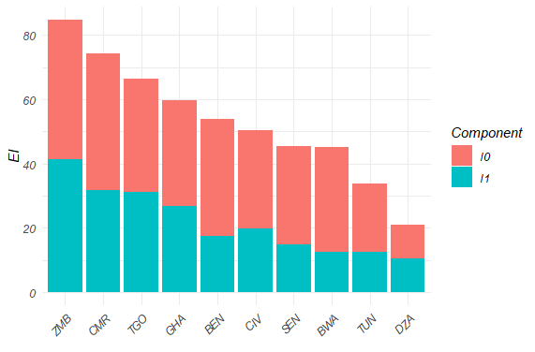
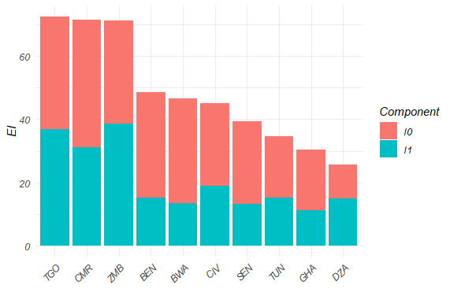
Result: Share of indicators contributing to EI score
I0 | Climate change indicators
I1 | Renewable energy and Energy transition indicators
EI | Environmental Index
EI performance for 2000
EI performance for 2020

Slide 8
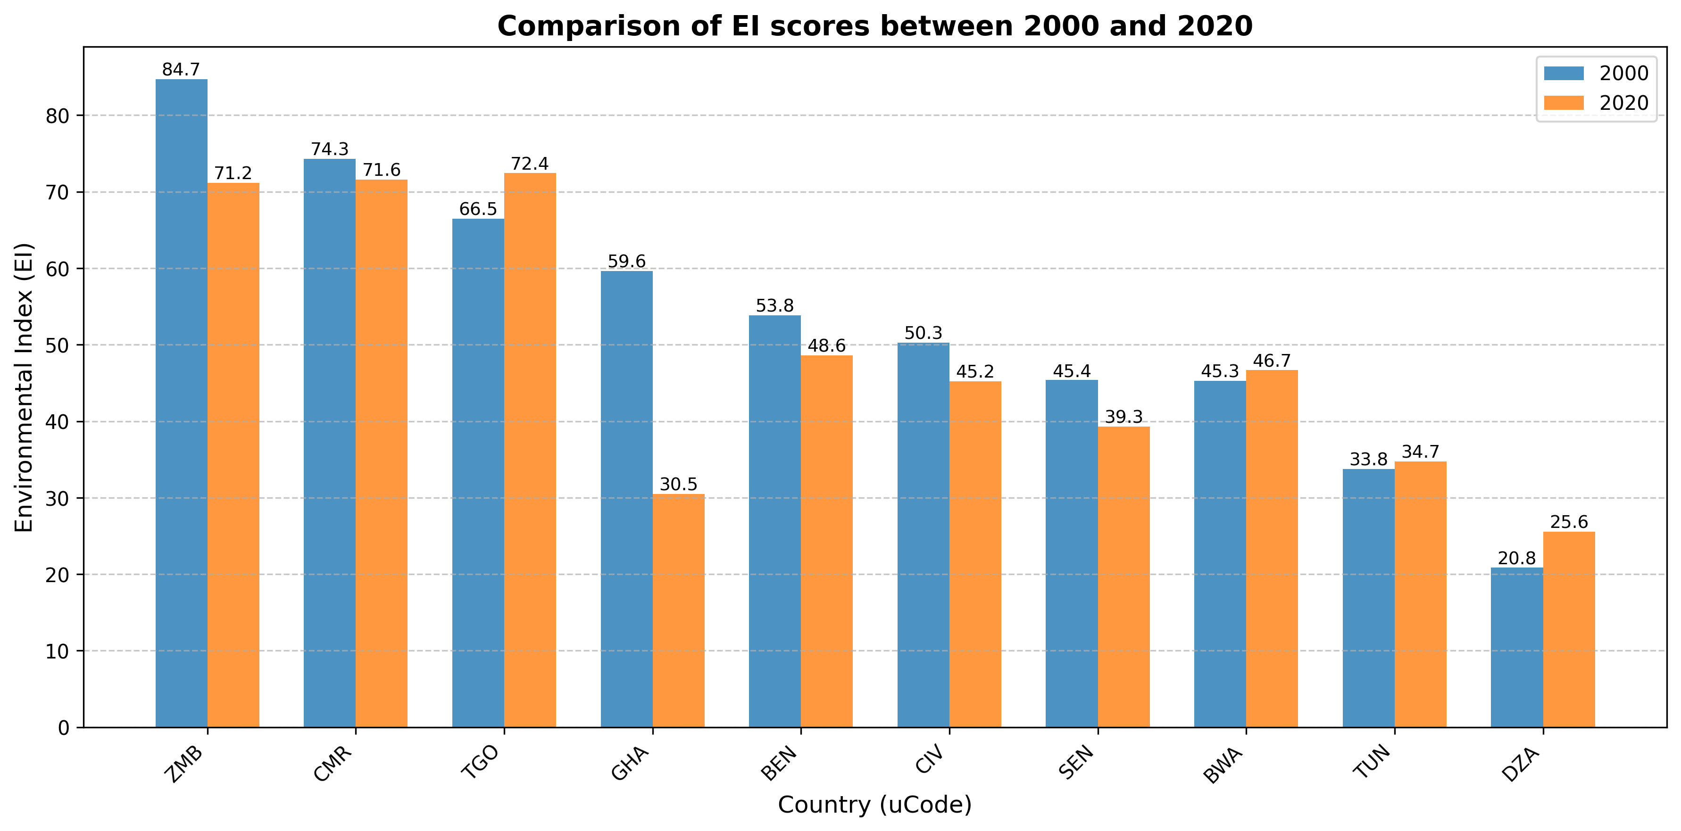
Result : Performance comparison chart

Slide 9
Analysis
Togo (TGO) moved from 3rd to 1st place, showing the highest improvement in environmental performance.
Cameroon (CMR) maintained its 2nd position, with only a slight decrease in its EI score.
Benin (BEN) improved from 5th to 4th place, while Botswana (BWA) climbed from 8th to 5th place, indicating progress in sustainability efforts.
Côte d’Ivoire (CIV) retained its 6th place, but its EI decrease from 50.27 to 45.2, suggesting environmental challenges that need to be addressed.
Senegal (SEN) presents the same trend by keeping its 7th place, with a decrease in its EI index from 45.37 to 39.29, indicating a worsening environmental situation.
Ghana (GHA) and Zambia (ZMB) saw significant declines, with Ghana dropping from 4th to 9th place and Zambia from 1st to 3rd place, reflecting worsening environmental conditions.
Algeria (DZA) and Tunisia (TUN), while remaining at the bottom, showed slight improvement in their EI scored.

Slide 10
Policy recommendation
Country | Focus
Togo (TGO) | Scale successful policies, focus on maintaining leadership in renewables.
Cameroon (CMR) | Improve air quality and energy progress (expand their renewables)
Benin (BEN) | Strengthen emission controls and scale clean energy.
Botswana (BWA) | Invest in air pollution reduction and sustainable electricity.
Côte d’Ivoire (CIV) and Senegal (SEN) | Reverse decline through renewable energy policy and GHG regulation.
Zambia (ZMB) and Ghana (GHA) | Recover top position with better energy policy, enforce emission regulations and reforestation
Tunisia (TUN) and Algeria (DZA) | Continue progress with stronger renewable energy investments.

